Slide 1

On Becoming a Leader in Risk Management
Fundamentals of RM
RM System and Process
Leadership in RM
Incident Investigation
RM Tools & Challenges
RM in Industry
People & Org.
Application and Perspectives
ENGG404 – Lecture
Case 11: Environmental Challenges
1
Notes:
ENGG404 Lecture 00 - Day 1
2012 Fall
1
1

Slide 2
Learning Outcomes:
At the end of this module, the student should be able to:
Apply critical thinking on a complex issue at a high level that involves the environment and the challenges we face.
Case 11: Environmental Challenges
2
Notes:
2

Slide 3
Pipelines – Good or Bad?
Why can’t we get any pipelines built in this country?
Historical spills and other disasters like Exxon Valdez
Cross-jurisdictional issues
Public opinion
But what are our other options?
Enbridge Northern Gateway Pipeline (Hardisty to Kitimat) – not approved by Canada, shelved.
TransCanada Energy East - shelved in 2017 by TransCanada (prices of oil – project not financially feasible).
TransCanada Keystone XL – rejected by Obama, reversed by Trump, approved by Trump, just received Nebraska approval.
Kinder Morgan Trans Mtn Twinning (Hardisty to Burnaby) – approval overturned by The Supreme Court; ownership acquired by GoC, now known as TMX, and recently approved (June 2019)
Enbridge Line 3 expansion (Hardisty to Wisconsin) – approved in Canada, waiting on US approval (construction already started?)
Case 11: Environmental Challenges
3
Notes:
3

Slide 4
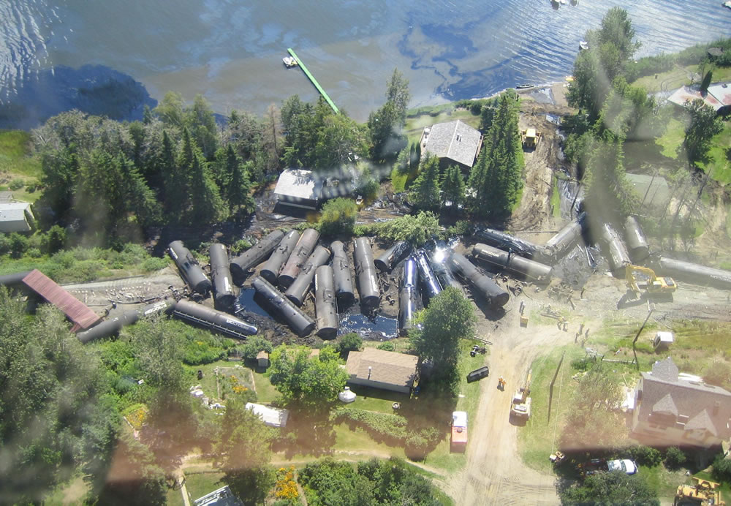
However we also have issues with rail transport of oil…
CN Rail at Lake Wabamun, Alberta August 3, 2005: No fatalities, no injuries; indeterminate aquatic life kill Almost 800,000 litres of heavy oils spilled into the lake 43 rail-cars, rail-bed, locomotives, several local properties, contents of the rail-cars $140 million in costs; rail-line out of service for several days, interruptions to supply customers
Case 11: Environmental Challenges
4

Slide 5
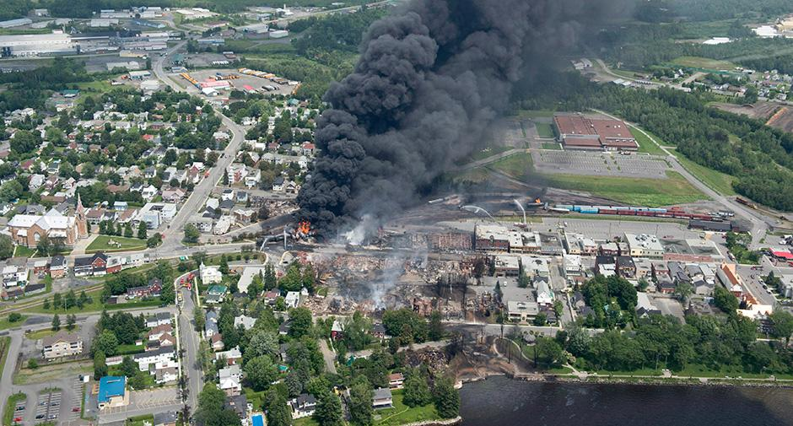
However we also have issues with rail transport of oil…
MMA Rail at Lac Megantic, Quebec – July 6, 2013 47 fatalities, 5 missing, over 2,000 evacuated Over 8 million litres of petroleum crude oil were spilled and caught fire, about 100,000 litres escaped to the near-by river; heavy smoke emitted and dispersed into the broader environment 72 rail-cars, rail-bed, car contents, Over 30 buildings destroyed, hundreds damaged, water supply contaminated Estimated clean-up costs and compensation: several hundreds of millions of dollars;
Case 11: Environmental Challenges
5

Slide 6
Issues Associated with Modern, Industrial Human Activity:
Pipeline versus railcar – oil transportation risks for sub-surface continuous vs over-land periodic.
Impact on PEAP resulting from incidents
Environmental impacts:
Risk of leaks& spills to land & in-land waters. Quantity? Detection?
Disruption of natural habitat – one-time vs on-going.
Hydrocarbons and CO2/GHG emissions due to production, transportation, and consumption
Upstream impacts? Downstream impacts?
What are these?
Need to critically think and analyze these!
Case 11: Environmental Challenges
6
Notes:
6

Slide 7
Issues Associated with Modern, Industrial Human Activity:
What is the bigger picture here?
As a society – we and our governments – what are our important priorities? Social? Economic? Environment?
Consider TransMountain Pipeline Expansion (TMX) and the question, “Who has more rights?”
People of AB, or People of BC, Or of Canada?
Indigenous or the Canadian society at large?
How do we balance competing interests?
Competitiveness, environmental regulations, indigenous rights, etc
Preserving non-renewable resources through reduced consumption & energy efficiency OR investing in the switch to renewables?
Is there a happy medium? Can we do it all?
Where’s the tipping point? Is it already here?
Case 11: Environmental Challenges
7
Notes:
7

Slide 8
Issues Associated with Modern, Industrial Human Activity:
Our challenges: Our efforts must be focused in two directions:
One looking back to address the legacy of issues of our industrial activities.
One looking at today and towards the future, to ensure that we manage the risks associated with our industries and operations so as prevent environmental incidents avoid adverse Environmental Challenges.
Our effort: We have the skills and technology, and where lacking, we have demonstrated our ingenuity to development the necessary skills and technology.
Our objective: to make the right decisions, the decisions that are best for a sustainable and livable environment.
Case 11: Environmental Challenges
8
Notes:
8

Slide 9
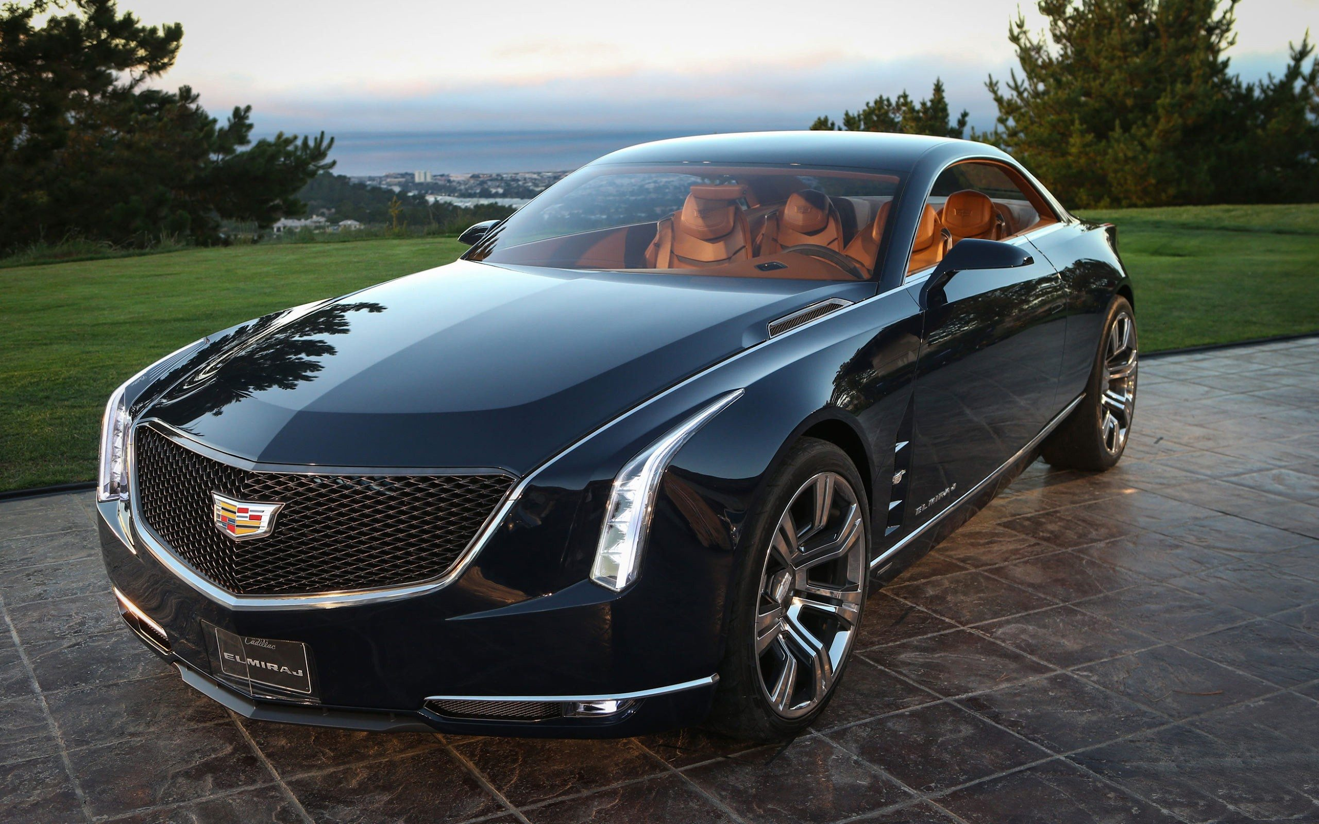
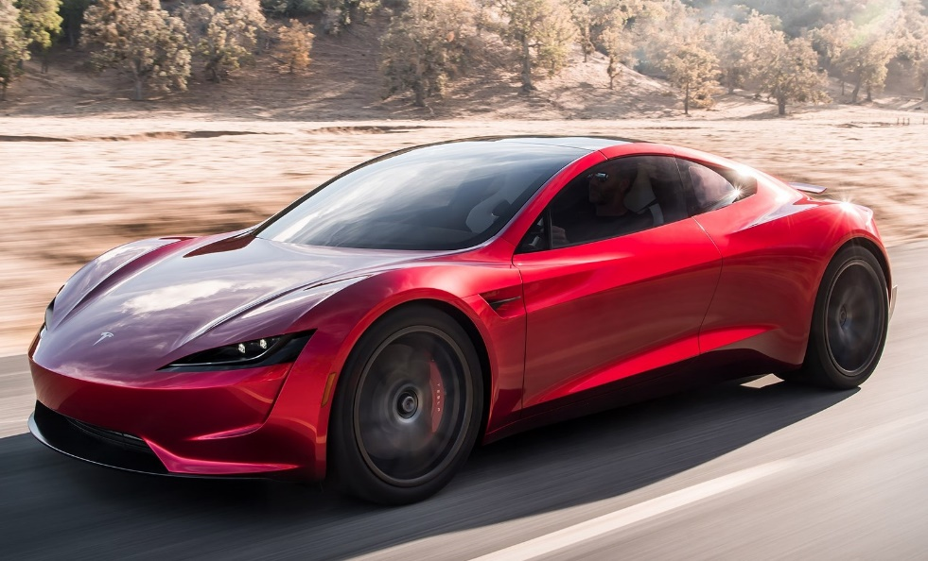


Are “Green Solutions” Really the Answer?
Conventional Gasoline Engine vs Electric?
Which one is better for the environment? Show of hands …
Left for Gasoline Right for Electric
Both hands if you are not sure.
Case 11: Environmental Challenges
9
Notes:
9

Slide 10
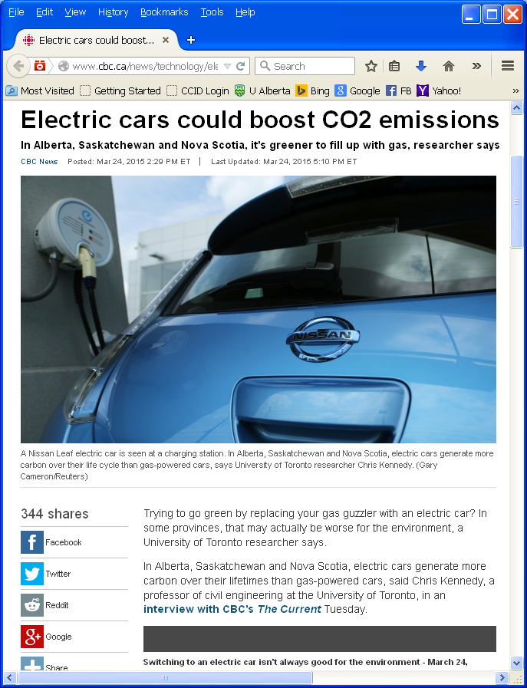
Are “Green Solutions” Really the Answer?
CBC News Article: “Electric cars could boost CO2 emissions in some provinces:
Trying to go green by replacing your gas guzzler with an electric car? In some provinces, that may actually be worse for the environment, a University of Toronto researcher says.”
http://www.cbc.ca/news/technology/electric-cars-could-boost-co2-emissions-in-some-provinces-1.3007409; Accessed 20150324
Case 11: Environmental Challenges
10
Notes:
10

Slide 11
Are “Green Solutions” Really the Answer?
Being “not sure” is not a bad thing!
Critical thinking: “The objective analysis and evaluation of the facts of an issue (an issue may have two or more opinions but only one set of facts) in order to form a judgement.”
“… a person strongly disposed toward critical thinking has a desire to follow reason and evidence wherever they may lead”
Such a person may hold two or more opinions on an issue during this period.
Ref: https://en.wikipedia.org/wiki/Critical_thinking https://en.oxforddictionaries.com/definition/critical_thinking
Case 11: Environmental Challenges
11
Notes:
11

Slide 12
Are “Green Solutions” Really the Answer?
Electrically Powered Motor Vehicle
Upstream:
Neg: mining for exotic metals for batteries, motors, wiring
Neg: requires new power generation capacity
Pos: renewable electrical energy source if hydro or solar or wind
Neg: non-renewable electrical energy source if coal or oil or natural gas
Neg or Pos: nuclear power stations?
Downstream:
Pos: no exhaust emissions
Neg: requires new infrastructure for recharging stations
Neg: disposal of spent / toxic metals
Neg. increases consumption of electricity
Pos: mature recycling industry will readily adapt to capturing value of exotic metals
Internal Combustion Gasoline Engine Vehicle
Upstream:
Pos: renewable bio-sources, ethanol
Neg: non-renewable fossil fuels
Downstream:
Neg: emissions from engines
Pos: existing fuel production & distribution network
Neg: consumes non-renewable resource
Pos: mature recycling industry
Case 11: Environmental Challenges
12
Notes:
12

Slide 13
Summary and Key Lessons:
So, you are now somewhat more skilled to compare the “green-ness” of the transportation of oil by Pipeline or with that by Tanker Railcar …
Identify the positive and negative impacts on the environment.
Consider:
Upstream side: during construction? during operation?
Downstream side: energy consumption to deliver one barrel of oil? potential quantity of oil leak or spill?
This is a simplistic approach and cannot be definitive in its conclusion; to be conclusive, quantitative data must be compared. This approach is intended to generate the questions that NEED to be answered with quantitative data.
Transportation of Oil via Pipeline
Upstream:
Downstream:
Transportation of Oil via Tanker Rail-car
Upstream:
Downstream:
13
Notes:
13

Slide 14
Summary and Key Lessons:
Solutions are not as simple as they may seem!
To accept and resolve challenges, critical thinking is a essential.
As a professional engineer, YOU WILL NEED TO:
Judge the evidence (i.e. apply critical thinking) in order to make informed decisions in light of:
Growing complexity and magnitude of information;
Diverse and differing expert opinions;
Provide clarity and “plain language” in the explanations of scientific and engineering concepts:
Applies to your team and decision-makers, as well as the public
People sometimes make decisions based on emotion, not only facts!
Make decisions based on validated evidence
Do your homework!
Use good, validated data in risk analyses.
Be very careful where you get your data from!
… because it is our professional duty.
Case 11: Environmental Challenges
14
Notes:
14

